Slide 1
PustakSahay
” Connecting Learners ,Sharing Knowledge”

Slide 2
TITLE: PUSTAKSAHAY – AN E-COMMERCE PLATFORM FOR USED BOOKS
Team members name and student code :
Swaraj Halder (BWU/BCA/22/129).
Debjyoti Mondal (BWU/BCA/22/131).
Antu Mallick (BWU/BCA/22/132) .
Samiran Chanak (BWU/BCA/22/138).
Raul Naskar (BWU/BCA/22/140) .
Priyankar Mondal (BWU/BCA/22/141).
Guided by : Prof. Kousik Dey

Slide 3



Problem Statement
High cost of new books - The high cost of new books makes education less accessible for many students. Rising prices force learners to seek alternatives like second-hand books or digital resources.
Lack of accessibility to study materials - The lack of accessibility to study materials creates a barrier to quality education for many students. Limited availability of books and resources affects learning opportunities, especially in underprivileged areas.
Less dedicated platform for book/note sharing among students - The lack of a dedicated platform for book and note sharing makes it difficult for students to access essential study materials.
Lack of Academic Incentives in Book Platforms - Existing platforms lack features that recognize or reward students' academic performance. There is a need for a system that offers incentives, such as grade-based discounts, to motivate students while making educational resources more accessible and affordable.

Slide 4


Project Objective
Promotes second-hand book sharing - Promoting second-hand book sharing helps reduce costs for students and makes education more affordable. It also supports sustainability by minimizing book waste and encouraging resource reuse.
Encourages knowledge exchange- Encouraging knowledge exchange helps students learn from each other and gain diverse perspectives. It fosters a collaborative learning environment where ideas and insights are freely shared.
Promote Academic Excellence through Incentives - The objective is to motivate students by offering discounts on used books based on their academic performance. This initiative aims to recognize and reward students' hard work while making educational resources more accessible and affordable.
Reduces book waste and supports sustainable learning - Reducing book waste through sharing and reuse helps conserve resources and protect the environment. It promotes sustainable learning by ensuring study materials are utilized efficiently and benefit more students.

Slide 5
Key Features
User-friendly interface for listing books and notes: A user-friendly interface for listing books and notes makes it easy for students to share and access study materials. Simple navigation and intuitive design enhance the experience, encouraging more participation.
Search and filter options: Search and filter options help students quickly find relevant books and notes based on their needs. These features improve accessibility by organizing materials efficiently for easy browsing.
Secure user authentication: Secure user authentication ensures that only verified students can access the platform, protecting privacy and data. It helps create a safe environment for book and note sharing by preventing unauthorized access.
Book availability status updates: These updates help users know which books are currently available or already taken. This feature ensures efficient sharing by reducing confusion and saving time for students.
Promote Academic Excellence - This initiative aims to recognize and reward students' hard work while making educational resources more accessible and affordable.

Slide 6
Tech Stack
Frontend: React.js
Backend: Node.js, Express.js
Database: MongoDB
Authentication: JWT
Storage: Multer, Cloudinary (for book images)

Slide 7
Backend Progress
User Registration & Login APIs: These APIs allow users to sign up and log in securely. They handle user credentials, store encrypted passwords, and generate authentication tokens for session management.
Book Upload & Retrieval APIs: These APIs enable users to upload books (including metadata and files) and retrieve book details. Users can fetch books individually or in bulk based on filters like genre, author, or title.
Authentication & Authorization: Implemented using JWT tokens or OAuth. Authentication ensures only registered users can access the system, while authorization controls user permissions, restricting access to specific actions based on roles (e.g., admin, user).

Slide 8
Planned FRONTEND FEATURES
Responsive UI with React & Tailwind CSS:
The frontend will be built using React for dynamic UI updates and Tailwind CSS for responsive, modern styling.
Mobile-first design ensures accessibility across all devices.
Book Listing Pages with Category Filters:
Users can browse books with filters such as category, author, title, or publication date.
Pagination and sorting options for better usability
User Dashboard for Managing Listings:
A dedicated dashboard where users can upload, edit, delete, and track their book listings.
Admin panel (if needed) for overseeing platform-wide book management.

Slide 9
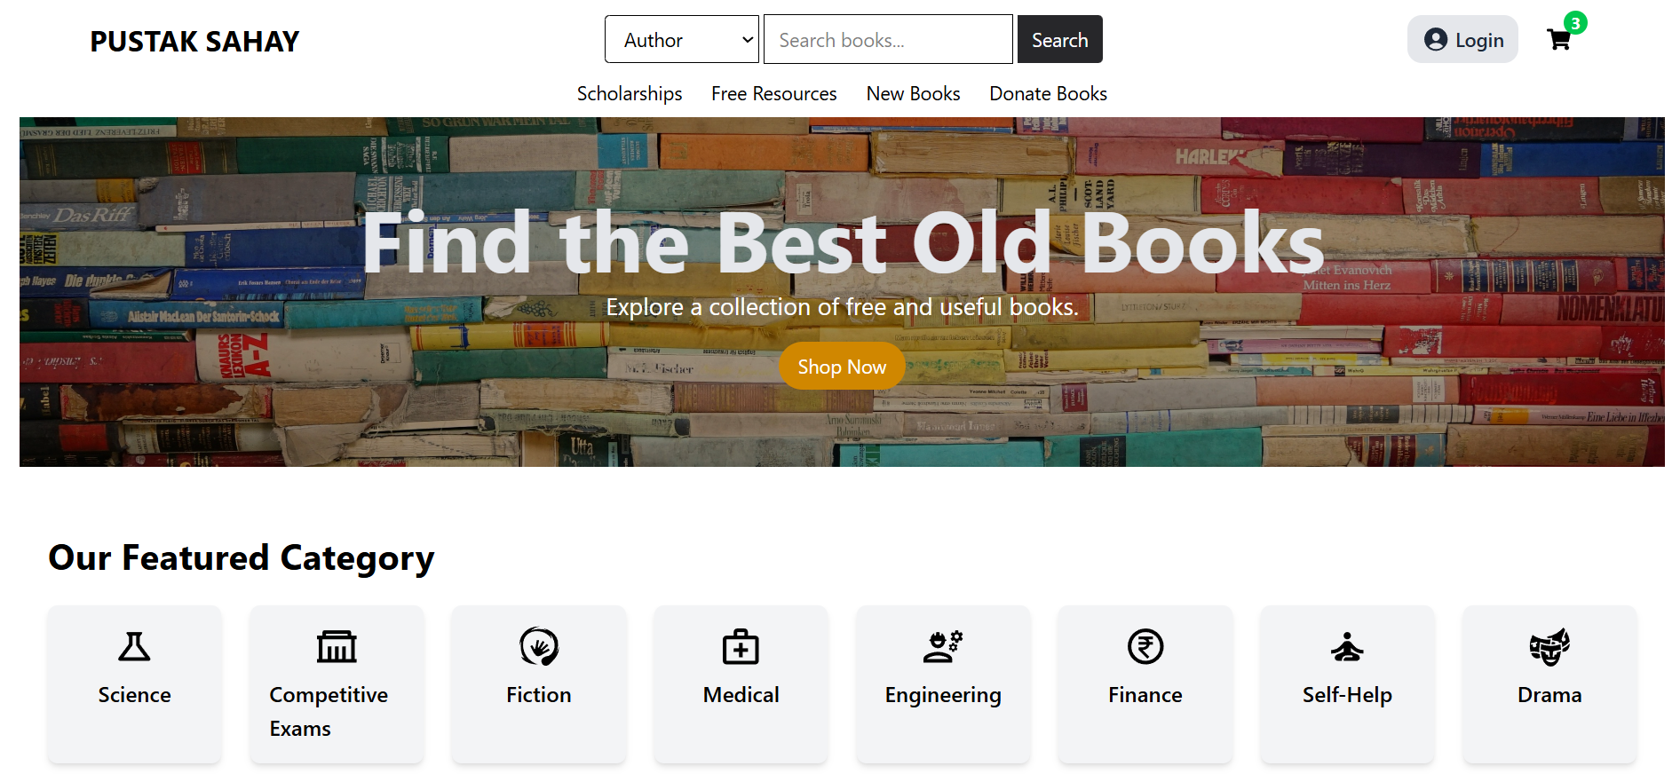
Over View Off Our Website Home Page

Slide 10
FUTURE SCOPE
Payment Gateway for Direct Purchases:
Integration with Stripe, PayPal, or Razorpay to allow users to buy books securely.
Supports multiple payment methods: credit/debit cards, UPI, wallets, etc.
Order confirmation and invoice generation.
Book Delivery Tracking:
Integration with shipment tracking APIs (e.g., Ekart, Delhivery) for real-time order tracking.
Users receive live updates on their dashboard regarding order status (Shipped, Out for Delivery, Delivered).
Rating System for Sellers/Buyers:
Star ratings & reviews for books and sellers.
Buyers can rate sellers based on their experience, and sellers can rate buyers for smooth transactions.
Helps maintain platform trust and credibility.
Mobile App Integration (Future Plans):
Developing a React Native or Flutter app for seamless access on mobile.
Sync with the web platform for cross-platform usability.
Push notifications for orders, messages, and book recommendations.

Slide 11
conclusion
PustakSahay aims to simplify the sharing of second-hand books and notes, making educational resources more affordable and accessible. With the backend successfully developed, the upcoming focus is on building an intuitive frontend and enhancing user interaction. We look forward to feedback to refine and complete the platform for maximum impact.

Slide 12
THANK YOU

